Slide 1
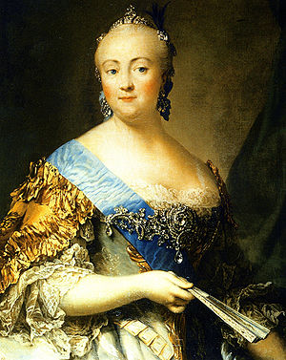
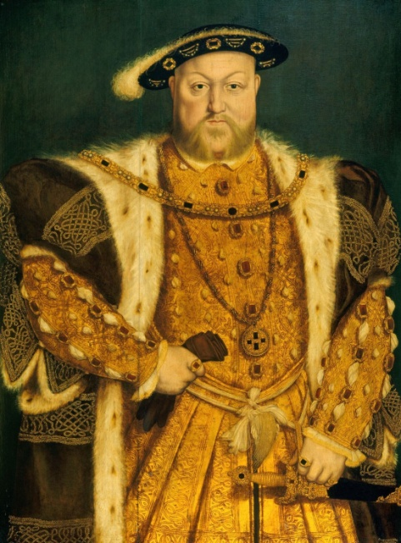
Kings and Queens
Starlight 4 Module 7
Word Lab
Учитель английского языка МОУ «ЦО Ревякинский»
Лисицына Ольга Львовна

Slide 2
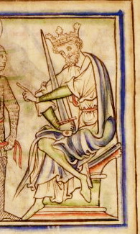
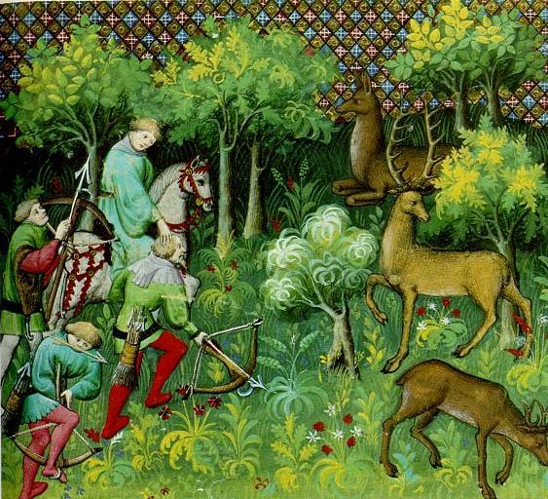
People called him “Harefoot”
because he was a fast runner and
a very good hunter.
Harold I (1035 – 1040)

Slide 3
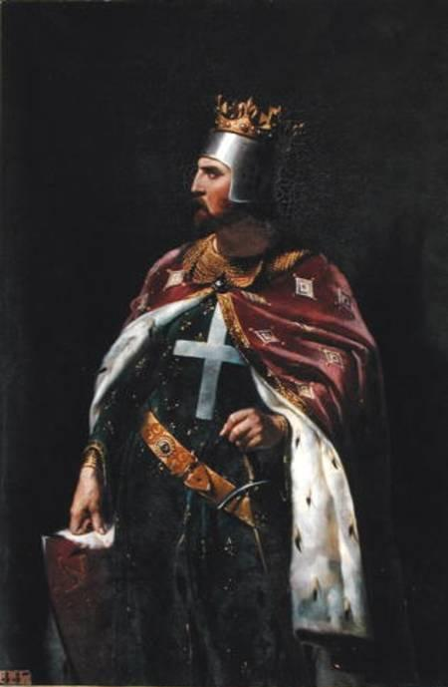

Richard I (1189-1199)
People called him “Lionheart”
because he was very brave.

Slide 4
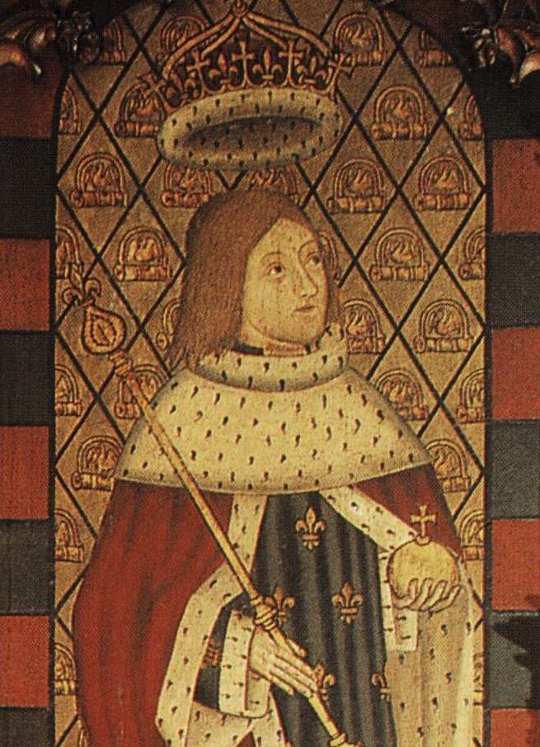
EDWARD V (1483)
He was king only for two months.

Slide 5

Henry VIII
(1509 – 1547)
His six wives were
Catherine of Aragon,
Anne Boleyn,
Jane Seymour,
Anne of Cleves,
Catherine Howard,
Catherine Parr.

Slide 6
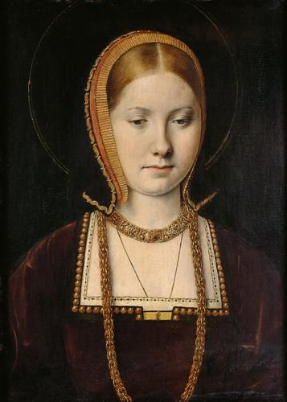
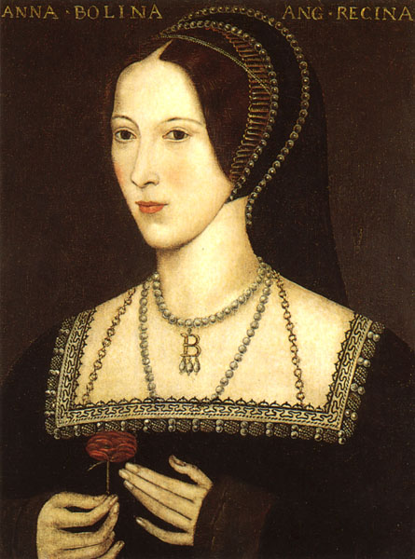
Catherine of Aragon
Anne Boleyn

Slide 7
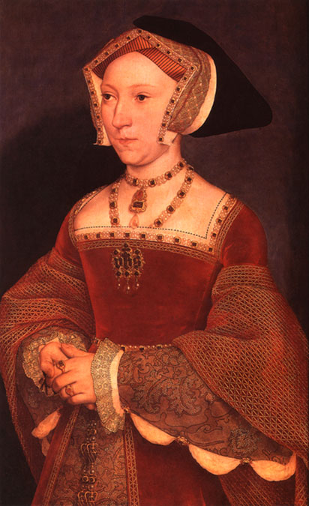
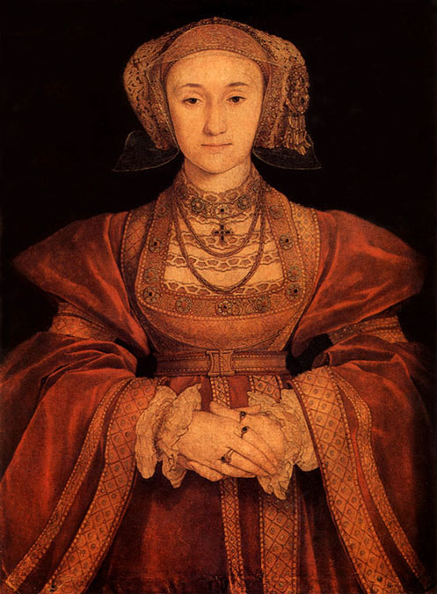
Jane Seymour
Anne of Cleves

Slide 8
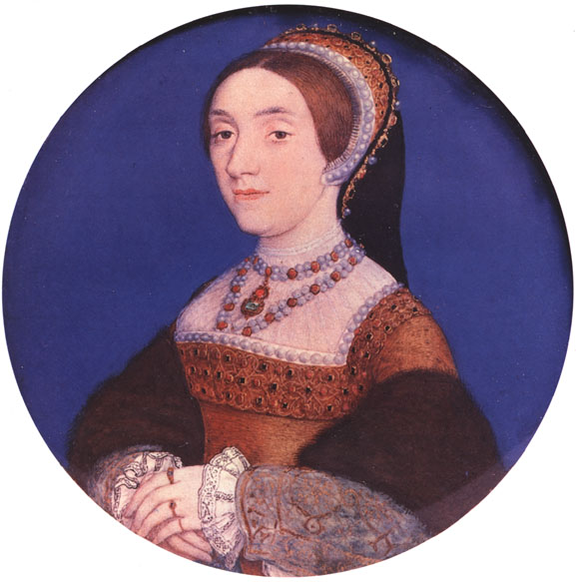
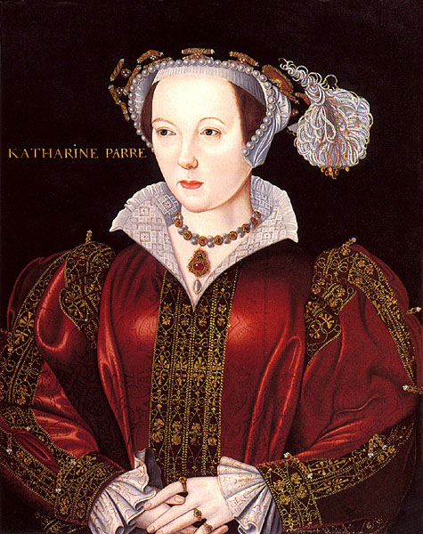
Catherine Parr
Catherine Howard

Slide 9
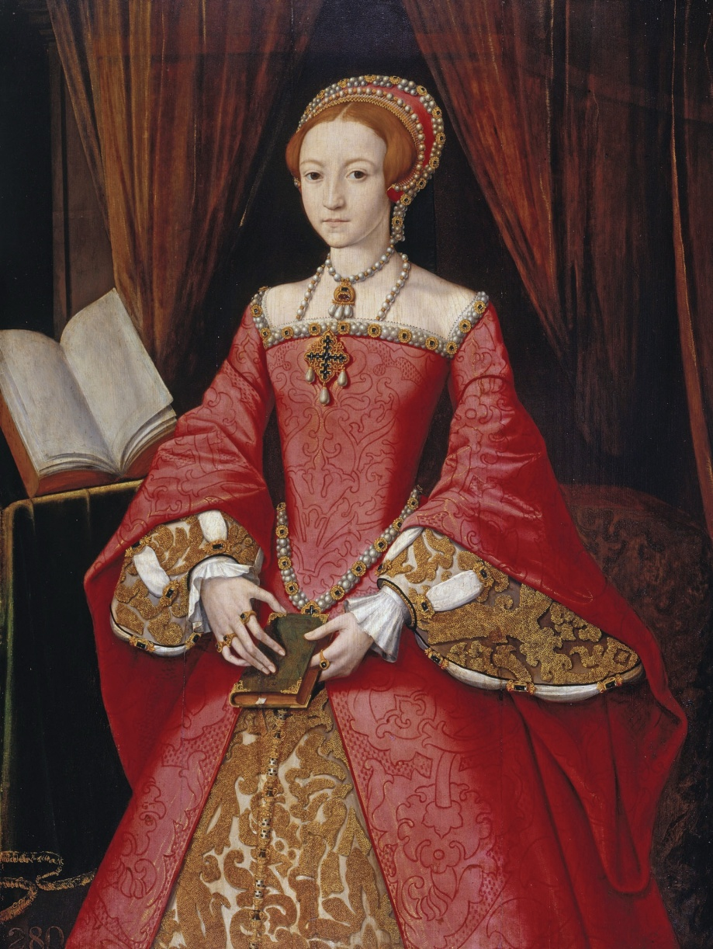
Elizabeth I
(1558 – 1603)
She was the daughter of Henry VIII .
People called her
“Good Queen Bess”

Slide 10
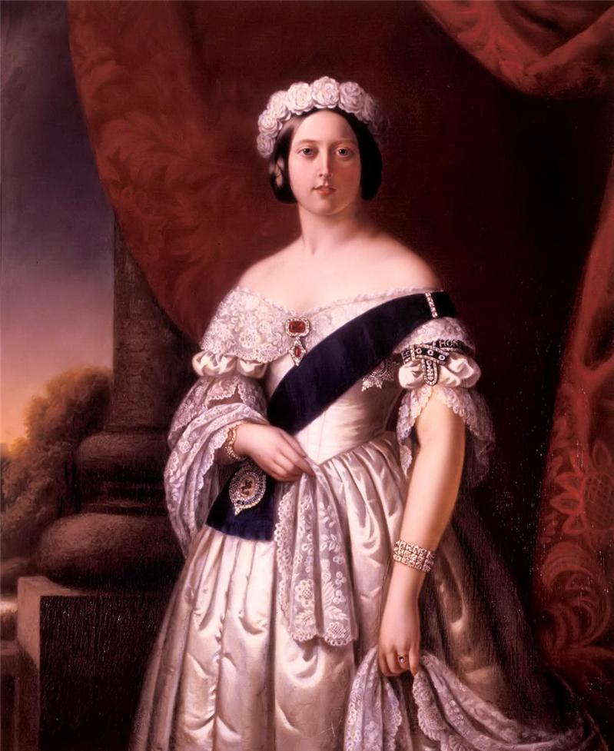
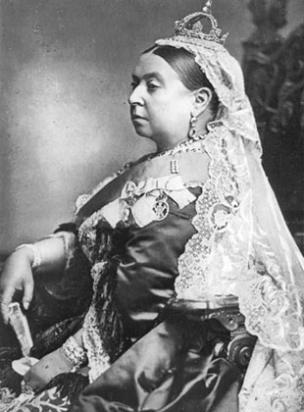
Victoria
(1837 – 1901)
She was queen for 63 years and 7 months – longer than
any other king or queen.

Slide 11
Elizabeth Petrovna
Empress Elizabeth I
(1709 – 1761)
She was the daughter of Peter the Great. She became Empress of Russia in 1741.

Slide 12
Answer the questions from Ex. 2, 4 p. 52-53
1.What was the true name of king “Harefoot”?
2. Who was the king only for 2 months?
3. What was the true name of king “Lionheart”?
4. How many wives did Henry VIII have?
5. Whom did people call “ Good Queen Bess”?
6. Who was the queen for 63 years and 7 months?
7. Who was the daughter of Peter the Great?
8. What did Empress Elizabeth I love doing?
9. How many languages could Empress Elizabeth I
speak?
10. Whose time on the throne was called “The Golden Age”?

